Slide 1
AESO Market Price Data Preparation
Austyn Nagribianko
January 21, 2020

Slide 2
Contents
Project Introduction
Data Output
Tool Specifications
Event Relationships

Slide 3
Project Introduction
Data Output
Tool Specifications
Event Relationships
Project Justification
Use Python to produce a tool for analyzing the market price response to AESO grid events

Slide 4
Project Introduction
Data Output
Tool Specifications
Event Relationships
Project Justification
Analyze Market Price Response to Grid Events
Data Prep Event Files
Determine Initial Correlations
SMP / Pool Price
Time of day
Intertie power exchange
Asset
Prep event files containing price data
Useful for ML / NN analysis
Any immediate relationships between event and price response?

Slide 5
Project Introduction
Data Output
Tool Specifications
Event Relationships
Tool Specifications
Event Data
Prepped Data Files
Database of grid event info
AESO Message Processing
Price event (>$200)
Minutes to largest SMP
Intertie power exchange
SMP and date / time for custom range before and after event
Separate files for each event

Slide 6
Project Introduction
Data Output
Tool Specifications
Event Relationships
Message Filtering
Keephills 2 off line.
Offline
Keephills 1 offline.
Online
Sundance #1 offline.
Maintenance
Keep Hills #1 Unit off line
Frequency Deviation
Sundance 6 On Line
Outage

Slide 7
Project Introduction
Data Output
Tool Specifications
Event Relationships
Message Filtering
Battle River 3 online.
[('Battle', 'NNP'), ('River', 'NNP'), ('3', 'CD'), ('online', 'NN'), ('.', '.')]
Asset = Battle 3 or Battle River 3

Slide 8
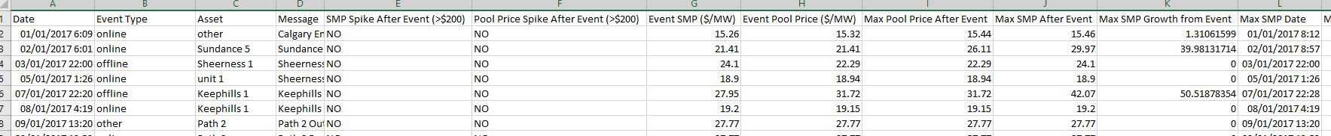
Project Introduction
Data Output
Tool Specifications
Event Relationships
Event Data

Slide 9
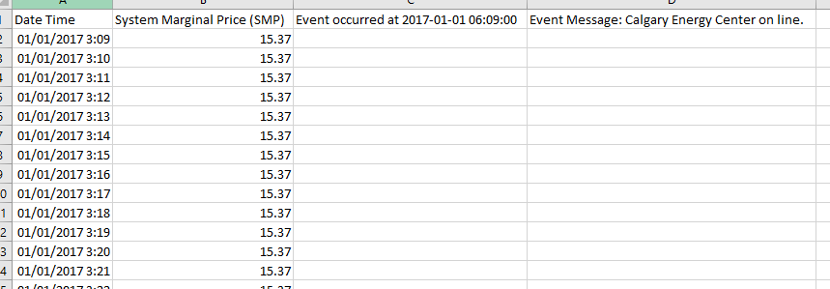
Project Introduction
Data Output
Tool Specifications
Event Relationships
Prepped Data Files

Slide 10
Project Introduction
Data Output
Tool Specifications
Event Relationships
Input Files
AESO Grid Events
SMPs
Pool Prices
AB Total Demand
AB Net Generation
Intertie Power Exchange
AB-MT
AB-BC
AB-SK
AB Total Intertie Exchange

Slide 11
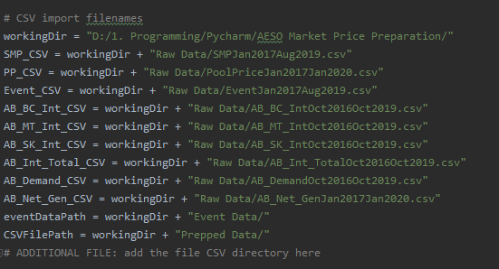
Project Introduction
Data Output
Tool Specifications
Event Relationships
File Specifications

Slide 12
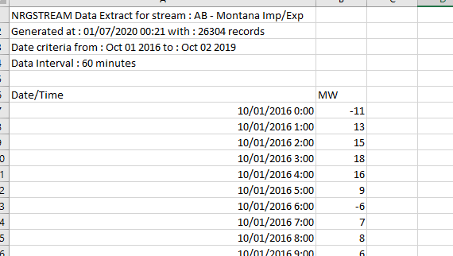
Project Introduction
Data Output
Tool Specifications
Event Relationships
File Specifications
Input Files
Program accounts for NRGStream header lines
Parses two columns
Date & time
MW / Price / Message / Etc
Does not account for third column

Slide 13
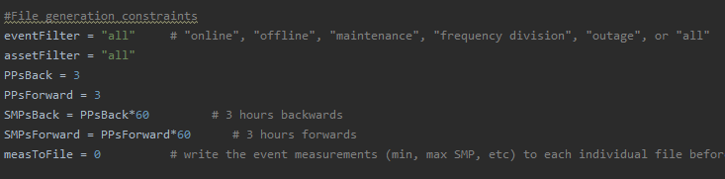
Project Introduction
Data Output
Tool Specifications
Event Relationships
Program Settings

Slide 14
Project Introduction
Data Output
Tool Specifications
Event Relationships
Immediate Observations
Average time to max SMP in price event
Intertie Impact
Coal Generation
Avg in SMP price events
48.78 minutes
Avg in pool price event
41.34 minutes
Avg intertie exchange
-181 MW
Avg during pool price event
-417.59 MW
Avg time to max SMP in PP spike
38.38 minutes
Avg intertie exchange
-439.21 MW

